Slide 1


ecs36b Fall 2022: Software Development & Object-Oriented Programming #02: Object-Oriented Paradigm (2/2)
Abstraction
Encapsulation
Polymorphism
Inheritance
Dr. S. Felix Wu
sfwu@ucdavis.edu

Slide 2
Two sides of OO*
Complexity of the Problem itself
Solving real problems!!
Better Software Development

Slide 3

Complexity of the Problem itself
Solving real problems!!
Better Software Development

Slide 4
Object-Oriented Paradigm
Object-oriented analysis and modeling
Object-oriented design
Object-oriented programming
Object-oriented languages/constructs

Slide 5
OO Principles
Data Abstraction
Polymorphism
Inheritance
Encapsulation

Slide 6
OO Programming in C++
Data Abstraction
Polymorphism
Inheritance
Encapsulation
class GPS{…}
latitude
longitude

Slide 7
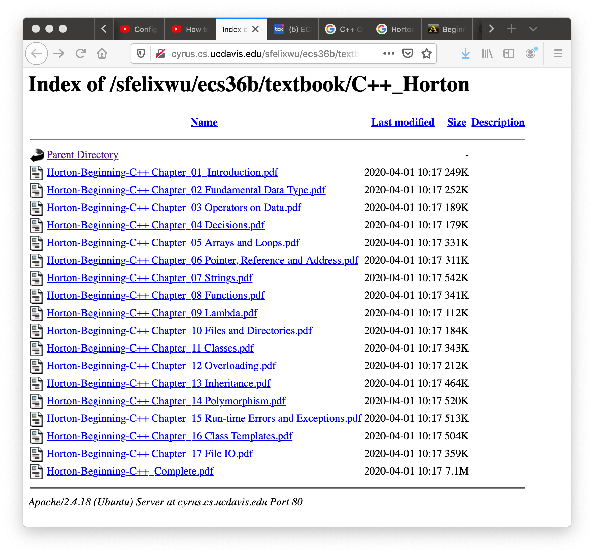

Slide 8
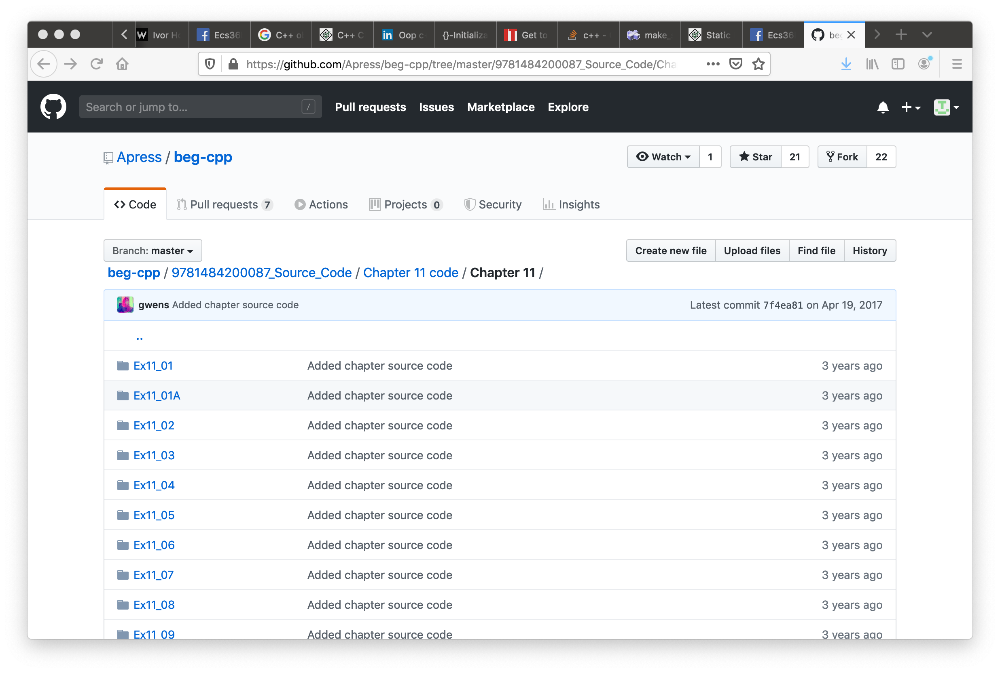

Slide 9
Objects/Classes
Data/attributes
Internal, external, inherited/protected
Methods (interface, member functions)
External, internal, inherited/protected, virtual

Slide 10
Objects/Classes
Data/attributes
Internal, external, inherited/protected
Methods (interface, member functions)
External, internal, inherited/protected, virtual
class class_name
{
private:
…
…
…
public:
…
…
…
};
latitude
longitude

Slide 11
Objects/Classes
Data/attributes
Internal, external, inherited/protected
Methods (interface, member functions)
External, internal, inherited/protected, virtual
class class_name
{
private:
…
…
…
public:
…
…
…
};

Slide 12
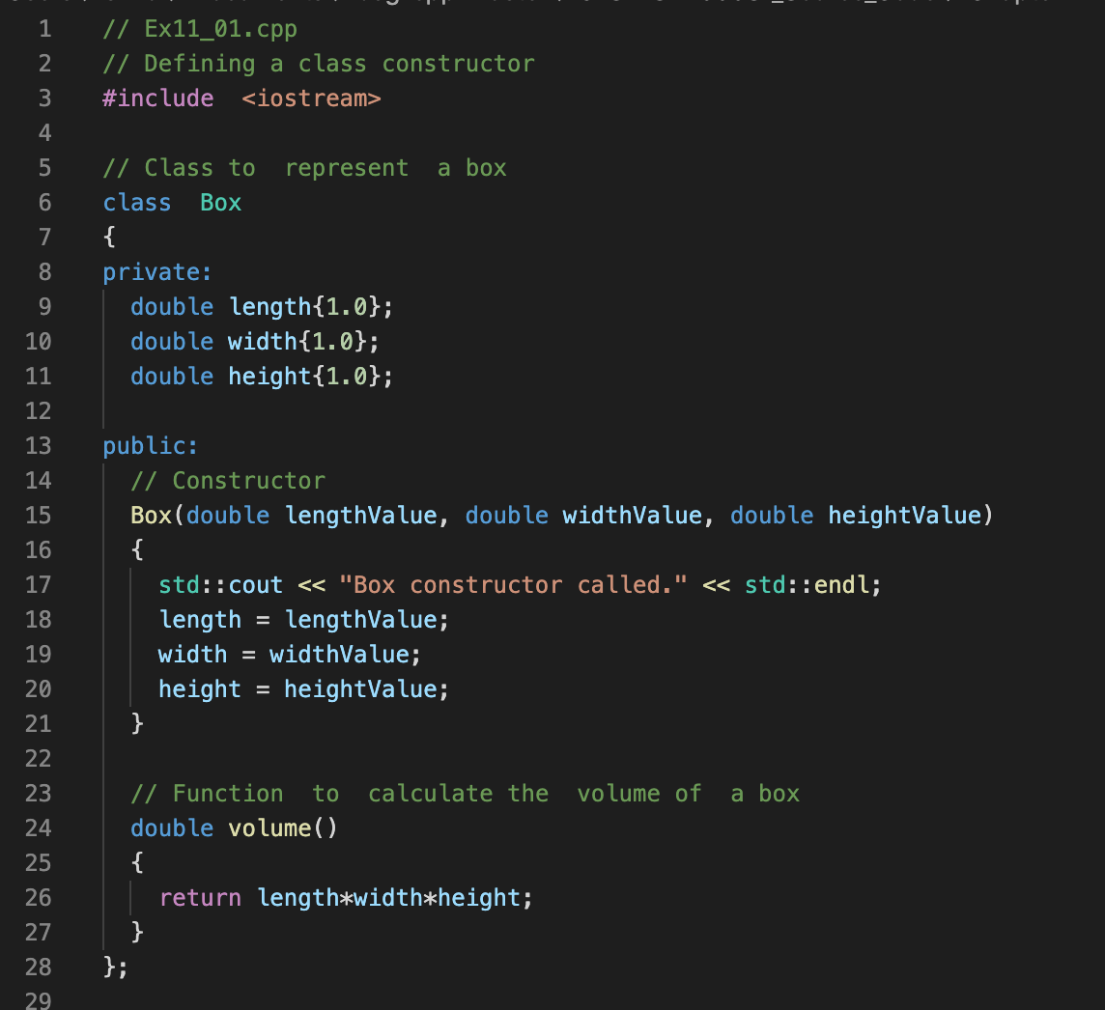

Slide 13
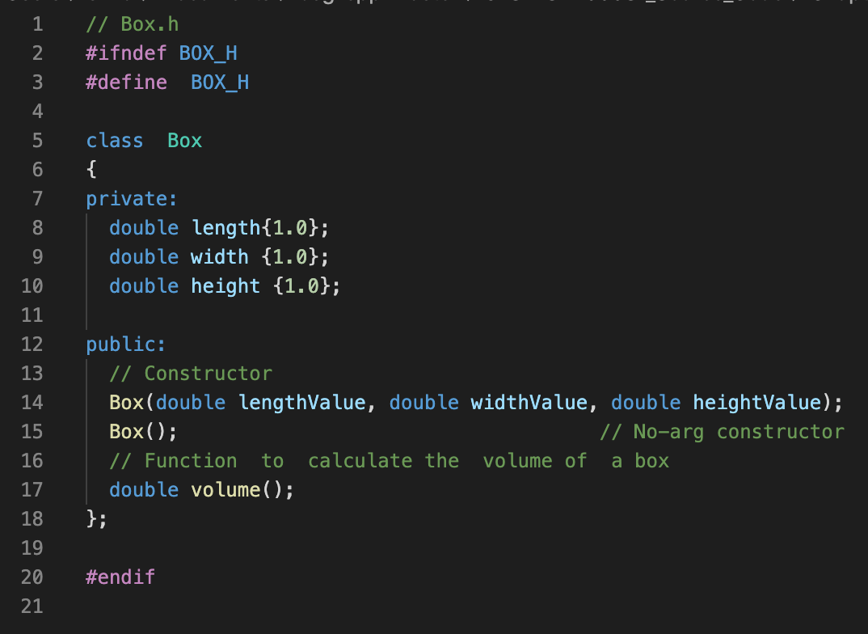

Slide 14
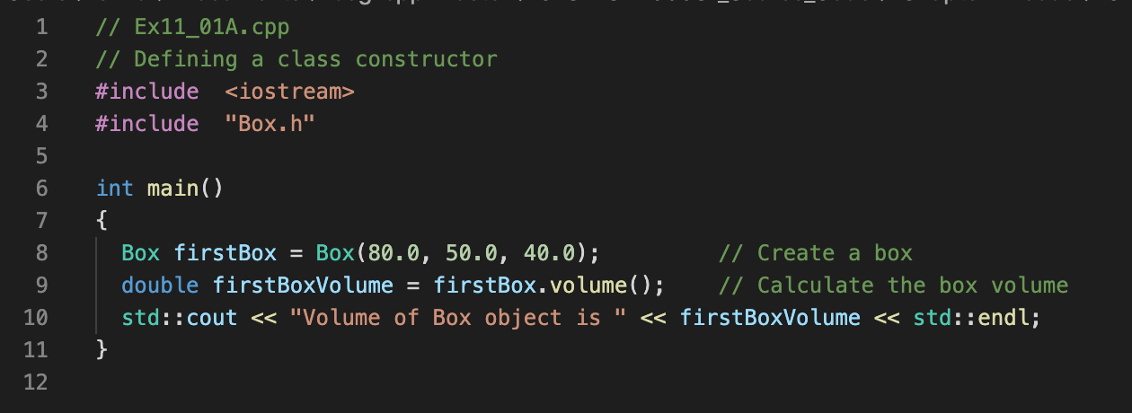
class Box;
C++ class, private and public
member functions
Constructors
V
length
width
height
C
C

Slide 15
class Box;
C++ class, private and public
member functions
Constructors
V
length
width
height
C
C

Slide 16
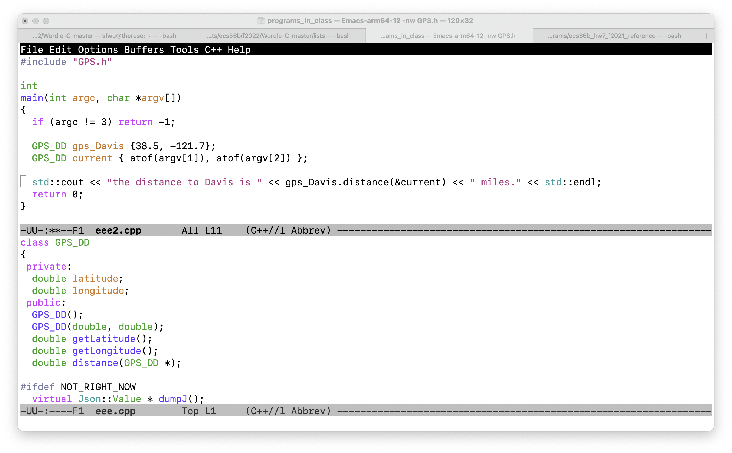

Slide 17
Function signature
Function name
Return data type
Input arguments and their data types.

Slide 18
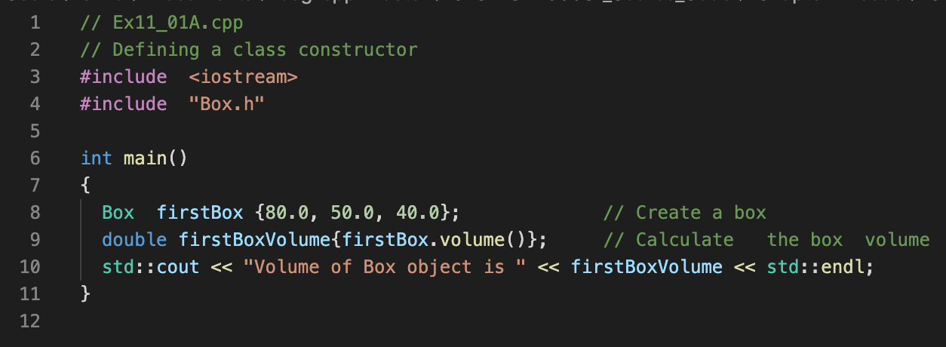
Felix’s version
Horton’s version

Slide 19
Felix’s version
Horton’s version

Slide 20
{ } Bracket Initialization
Available only after C++11
C++98 C++03 C++11 C++14 C++17 C++2a
g++ -std=c++2a Ex11_01A.cpp Box.cpp -o Ex11_01A

Slide 21
class Box;
C++ class, private and public
member functions
Constructors
Bracket Initialization
Namespace (Chapter 1, Horton)
V
length
width
height
C
C

Slide 22
Let us run some C++ programs!

Slide 23
double distance_calculated;
distance_calculated = gps_Davis.distance(current);
distance_calculated = gps_Davis.distance(GPS_DD {atof(argv[1]), atof(argv[2])});
distance_calculated = gps_Davis.distance({atof(argv[1]), atof(argv[2])});
distance_calculated = gps_Davis.distance({});

Slide 24
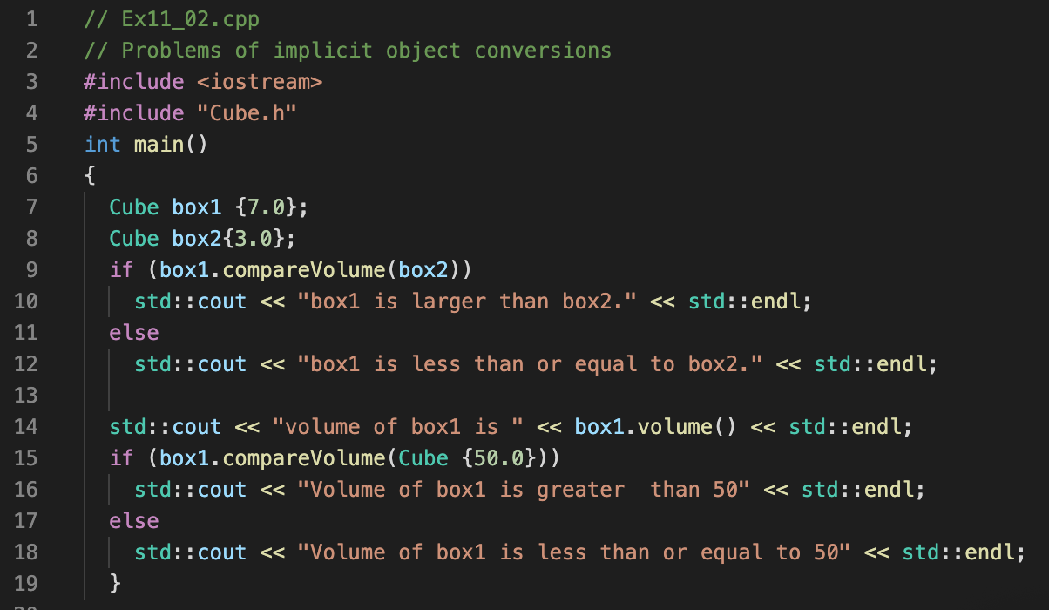
Good or bad?

Slide 25
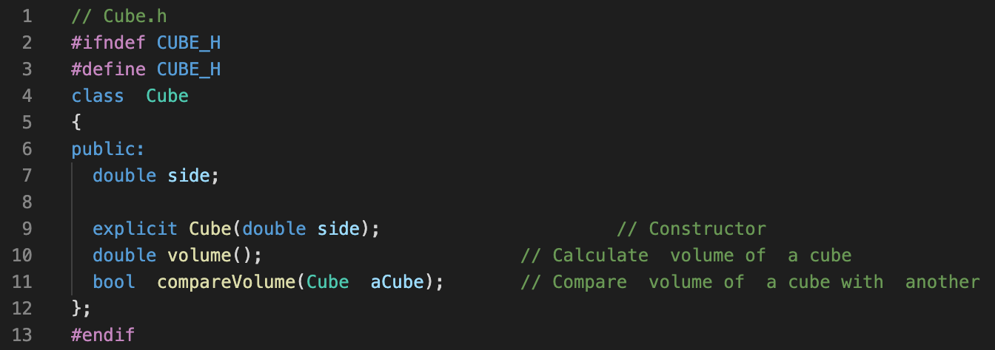
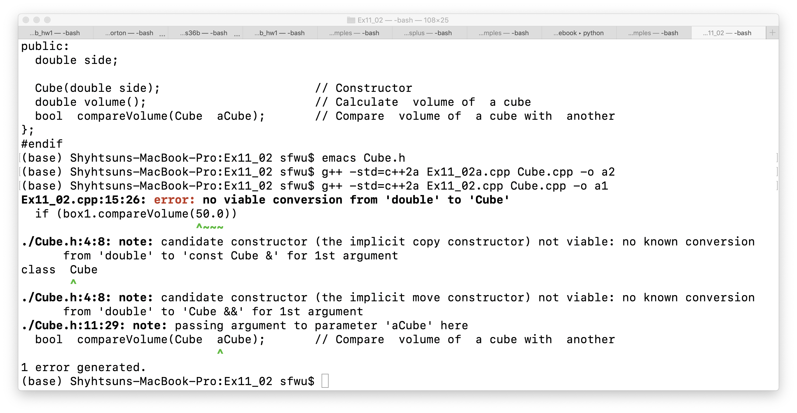

Slide 26
V
length
width
height
class
C
C
Can we track easily how many objects from this class have been created?
objects

Slide 27
V
length
width
height
Class Transaction
static variable
C
C
Can we track easily how many objects from this class have been created?
objects

Slide 28
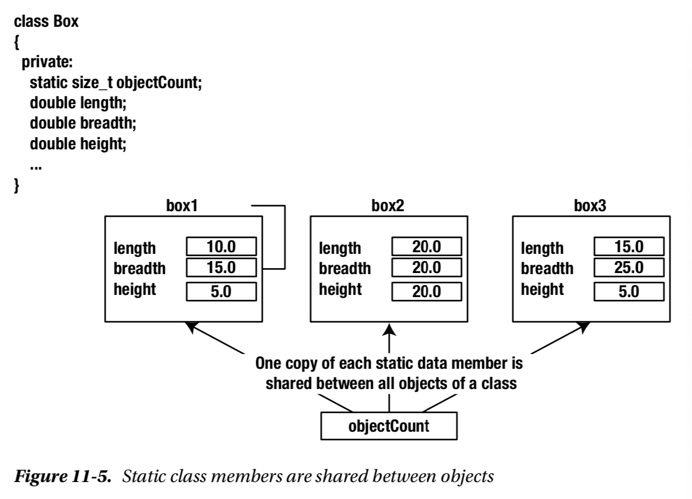

Slide 29
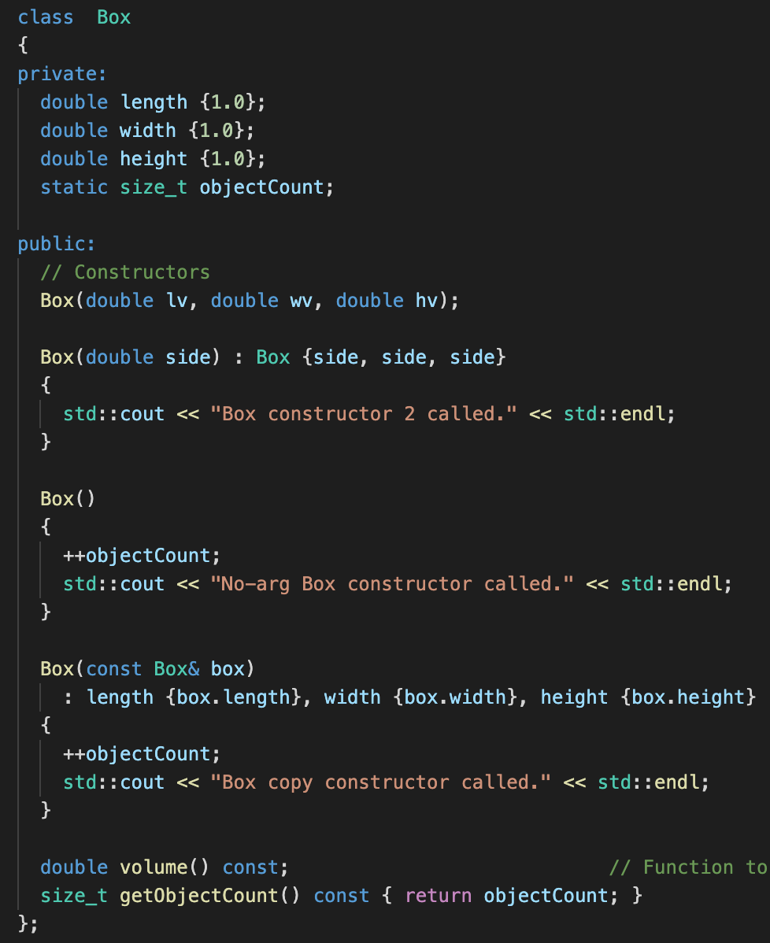

Slide 30
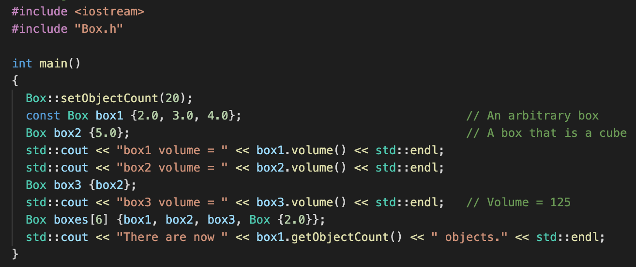
Accessing static variables before any object created

Slide 31
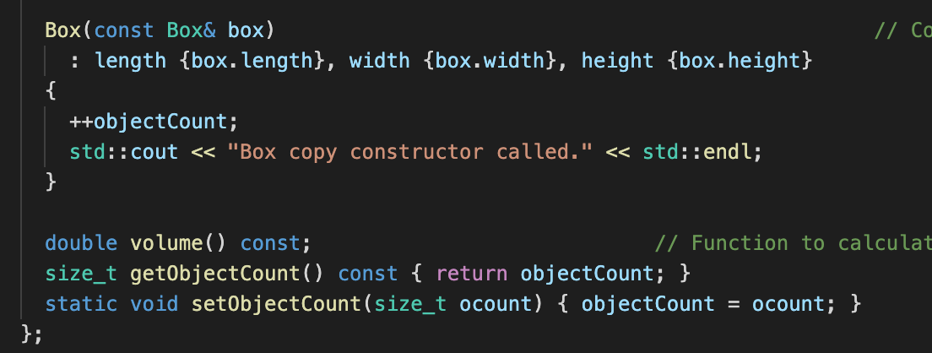
Box.h

Slide 32
#include "Transaction.h"
unsigned int Transaction::transaction_count { };
// unsigned int transaction_count = 0;
Transaction::Transaction(unsigned int arg_type)
{
Transaction::transaction_count++;
this->tr_type = arg_type;
}

Slide 33
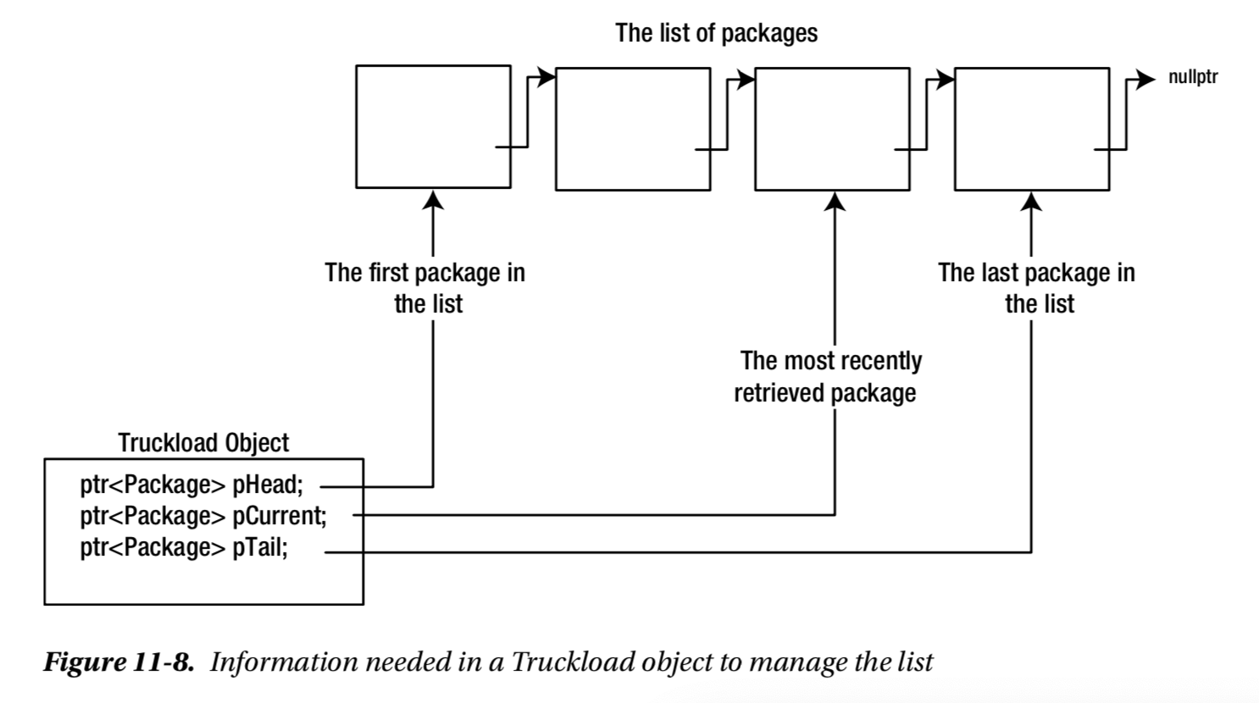

Slide 34
An Object
Integrity/Protection
Reusability
Abstraction

Slide 35
Two sides of OO*
Complexity of the Problem itself
Choosing the right-level of abstraction
Solving real problems!!
If you haven’t written the program, you don’t know what you are talking about!
Better Software Development

